Slide 1
Chapter 1. Basic Structure of Computers

Slide 2
Functional Units
Arithmetic
Input
and
logic
Memory
Output
Control
I/O
Processor
Figure 1.1. Basic functional units of a computer.

Slide 3
Information Handled by a Computer
Instructions/machine instructions
Govern the transfer of information within a computer as well as between the computer and its I/O devices
Specify the arithmetic and logic operations to be performed
Program
Data
Used as operands by the instructions
Source program
Encoded in binary code – 0 and 1

Slide 4
Memory Unit
Store programs and data
Two classes of storage
Primary storage
Fast
Programs must be stored in memory while they are being executed
Large number of semiconductor storage cells
Processed in words
Address
RAM and memory access time
Memory hierarchy – cache, main memory
Secondary storage – larger and cheaper

Slide 5
Arithmetic and Logic Unit (ALU)
Most computer operations are executed in ALU of the processor.
Load the operands into memory – bring them to the processor – perform operation in ALU – store the result back to memory or retain in the processor.
Registers
Fast control of ALU

Slide 6
Control Unit
All computer operations are controlled by the control unit.
The timing signals that govern the I/O transfers are also generated by the control unit.
Control unit is usually distributed throughout the machine instead of standing alone.
Operations of a computer:
Accept information in the form of programs and data through an input unit and store it in the memory
Fetch the information stored in the memory, under program control, into an ALU, where the information is processed
Output the processed information through an output unit
Control all activities inside the machine through a control unit

Slide 7
Basic Operational Concepts

Slide 8
Review
Activity in a computer is governed by instructions.
To perform a task, an appropriate program consisting of a list of instructions is stored in the memory.
Individual instructions are brought from the memory into the processor, which executes the specified operations.
Data to be used as operands are also stored in the memory.

Slide 9
A Typical Instruction
Add LOCA, R0
Add the operand at memory location LOCA to the operand in a register R0 in the processor.
Place the sum into register R0.
The original contents of LOCA are preserved.
The original contents of R0 is overwritten.
Instruction is fetched from the memory into the processor – the operand at LOCA is fetched and added to the contents of R0 – the resulting sum is stored in register R0.

Slide 10
Separate Memory Access and ALU Operation
Load LOCA, R1
Add R1, R0
Whose contents will be overwritten?

Slide 11
Connection Between the Processor and the Memory

Slide 12
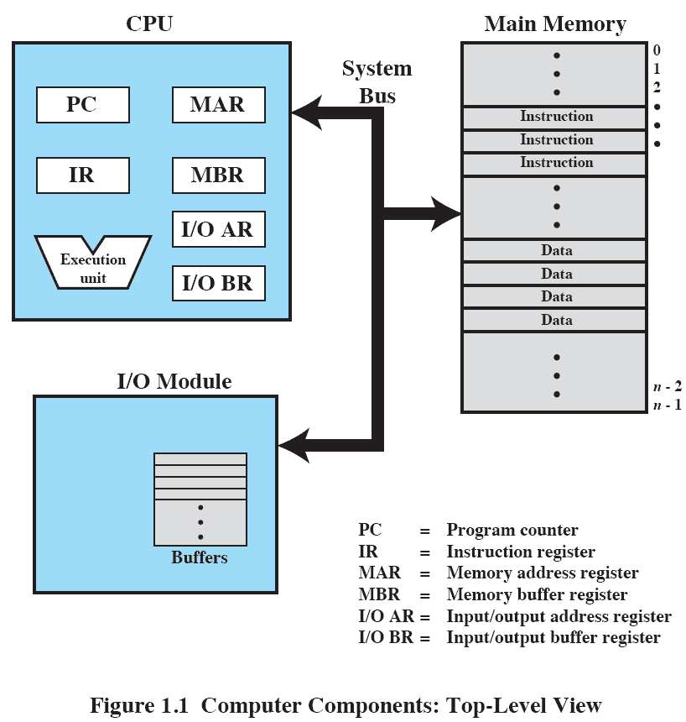
Computer Components: Top-Level View

Slide 13
Registers
Instruction register (IR)
Program counter (PC)
General-purpose register (R₀ – R_{n-1})
Memory address register (MAR)
Memory data register (MDR)

Slide 14
Instruction Execution
Two steps
Processor reads (fetches) instructions from memory
Processor executes each instruction

Slide 15
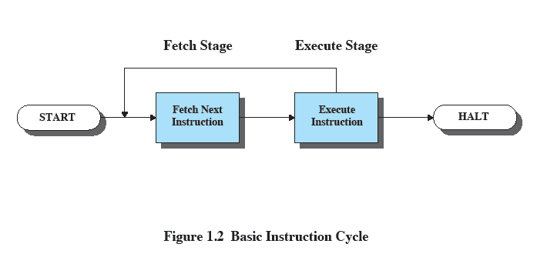
Basic Instruction Cycle

Slide 16
Instruction Fetch and Execute
The processor fetches the instruction from memory
Program counter (PC) holds address of the instruction to be fetched next
PC is incremented after each fetch

Slide 17
Instruction Register
Fetched instruction loaded into instruction register
Categories
Processor-memory, processor-I/O, data processing, control

Slide 18
Typical Operating Steps
Programs reside in the memory through input devices
PC is set to point to the first instruction
The contents of PC are transferred to MAR
A Read signal is sent to the memory
The first instruction is read out and loaded into MDR
The contents of MDR are transferred to IR
Decode and execute the instruction

Slide 19
Typical Operating Steps (Cont’)
Get operands for ALU
General-purpose register
Memory (address to MAR – Read – MDR to ALU)
Perform operation in ALU
Store the result back
To general-purpose register
To memory (address to MAR, result to MDR – Write)
During the execution, PC is incremented to the next instruction

Slide 20
Bus Structures
There are many ways to connect different parts inside a computer together.
A group of lines that serves as a connecting path for several devices is called a bus.
Address/data/control

Slide 21
Bus Structure
Single-bus

Slide 22
Addressing Modes
Immediate
Direct
Indirect
Register
Register Indirect
Displacement (Indexed)
Stack
Notes:
2

Slide 23
Immediate Addressing
Operand is part of instruction
Operand = address field
e.g. ADD 5
Add 5 to contents of accumulator
5 is operand
No memory reference to fetch data
Fast
Limited range
Notes:
3

Slide 24
Immediate Addressing Diagram
Instruction
Opcode
Operand
Notes:
4

Slide 25
Direct Addressing
Address field contains address of operand
Effective address (EA) = address field (A)
e.g. ADD A
Add contents of cell A to accumulator
Look in memory at address A for operand
Single memory reference to access data
No additional calculations to work out effective address
Limited address space
Notes:
5

Slide 26
Direct Addressing Diagram
Instruction
Opcode
Address A
Memory
Operand
Notes:
6

Slide 27
Indirect Addressing (1)
Memory cell pointed to by address field contains the address of (pointer to) the operand
EA = (A)
Look in A, find address (A) and look there for operand
e.g. ADD (A)
Add contents of cell pointed to by contents of A to accumulator
Notes:
7

Slide 28
Indirect Addressing (2)
Large address space
2^{n} where n = word length
May be nested, multilevel, cascaded
e.g. EA = (((A)))
Draw the diagram yourself
Multiple memory accesses to find operand
Hence slower
Notes:
8

Slide 29
Indirect Addressing Diagram
Instruction
Opcode
Address A
Memory
Pointer to operand
Operand
Notes:
9

Slide 30
Register Addressing (1)
Operand is held in register named in address filed
EA = R
Limited number of registers
Very small address field needed
Shorter instructions
Faster instruction fetch
Notes:
10

Slide 31
Register Addressing (2)
No memory access
Very fast execution
Very limited address space
Multiple registers helps performance
Requires good assembly programming or compiler writing
N.B. C programming
register int a;
c.f. Direct addressing
Notes:
11

Slide 32
Register Addressing Diagram
Instruction
Opcode
Register Address R
Registers
Operand
Notes:
12

Slide 33
Register Indirect Addressing
C.f. indirect addressing
EA = (R)
Operand is in memory cell pointed to by contents of register R
Large address space (2^{n})
One fewer memory access than indirect addressing
Notes:
13

Slide 34
Register Indirect Addressing Diagram
Instruction
Opcode
Register Address R
Memory
Registers
Pointer to Operand
Operand
Notes:
14

Slide 35
Displacement Addressing
EA = A + (R)
Address field hold two values
A = base value
R = register that holds displacement
or vice versa
Notes:
15

Slide 36
Displacement Addressing Diagram
Instruction
Opcode
Register R
Address A
Memory
Registers
Pointer to Operand
+
Operand
Notes:
16

Slide 37
Relative Addressing
A version of displacement addressing
R = Program counter, PC
EA = A + (PC)
i.e. get operand from A cells from current location pointed to by PC
c.f locality of reference & cache usage
Notes:
17

Slide 38
Base-Register Addressing
A holds displacement
R holds pointer to base address
R may be explicit or implicit
e.g. segment registers in 80x86
Notes:
18

Slide 39
Indexed Addressing
A = base
R = displacement
EA = A + R
Good for accessing arrays
EA = A + R
R++
Notes:
19

